Slide 1
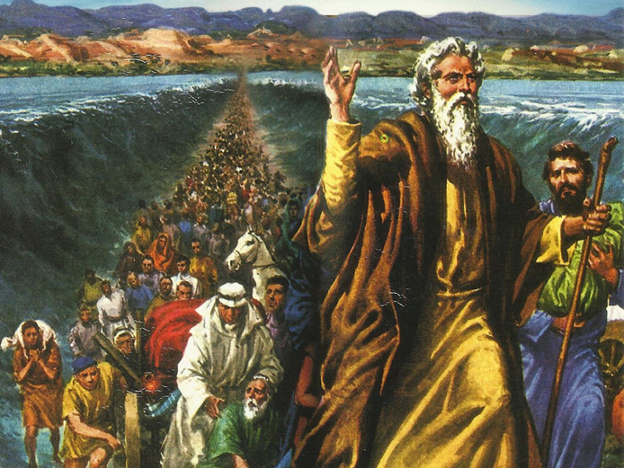
CATECHETICAL TEXTBOOK SERIES OF THE SYRO - MALABAR CHURCH
ON THE PATH OF SALVATION - 5
PEOPLE WHO AWAITED THE REDEEMER
5

Slide 2

LESSON 1
BIBLE THE HISTORY OF SALVATION

Slide 3
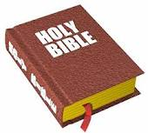
Bible means ‘book’.
Derived from Greek word ‘biblia’.
Collection of books.
Has 73 books and divided in two sections.
Old Testament - 46 books
New Testament - 27 books.
Role : God our loving Father talks to us through the bible.
Not only for Christians but also whole of humanity.

Slide 4

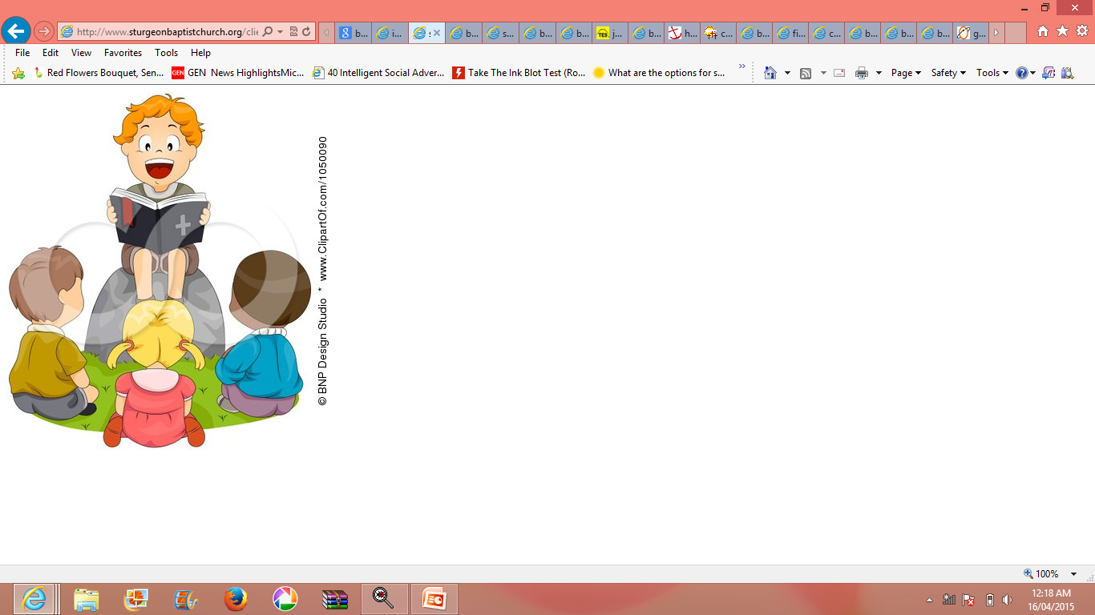
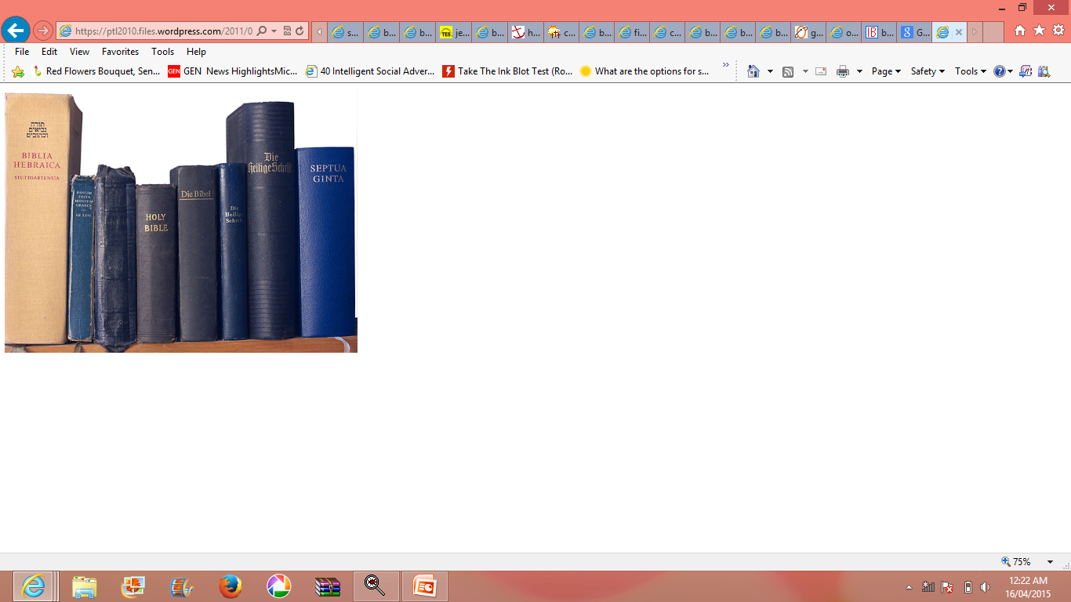
INTERESTING FACTS
Most read book
Most sold book
Largest number of copies printed.
Publish in largest number of languages.

Slide 5
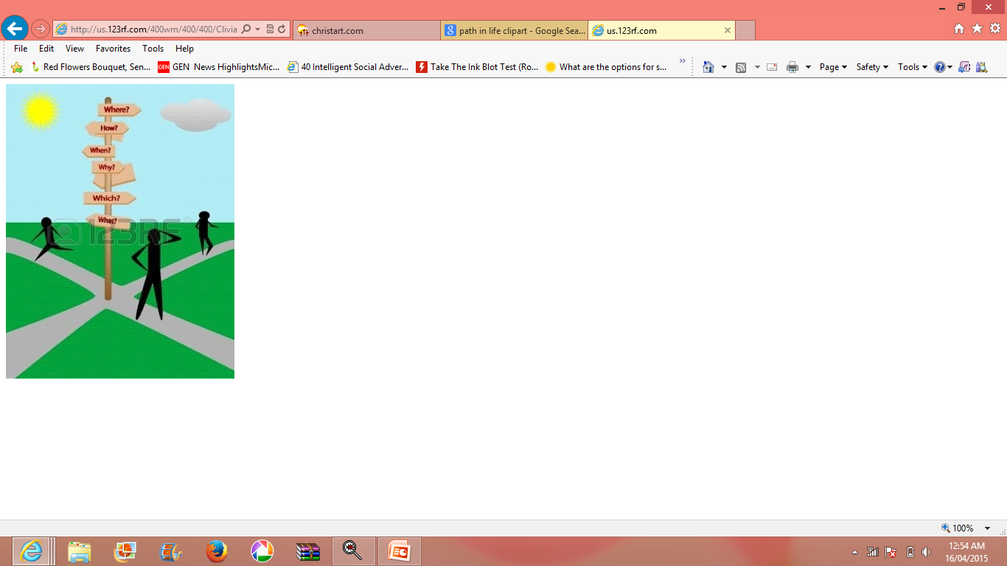
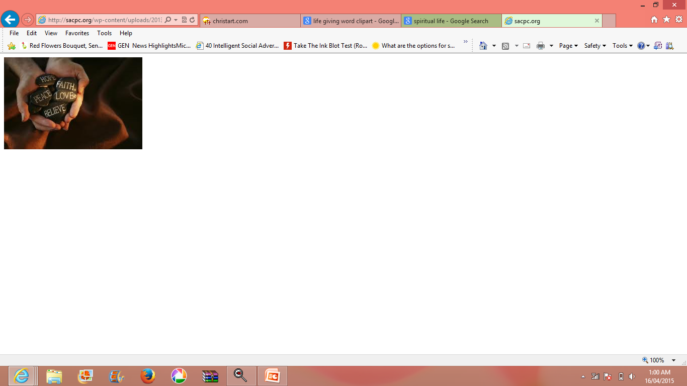
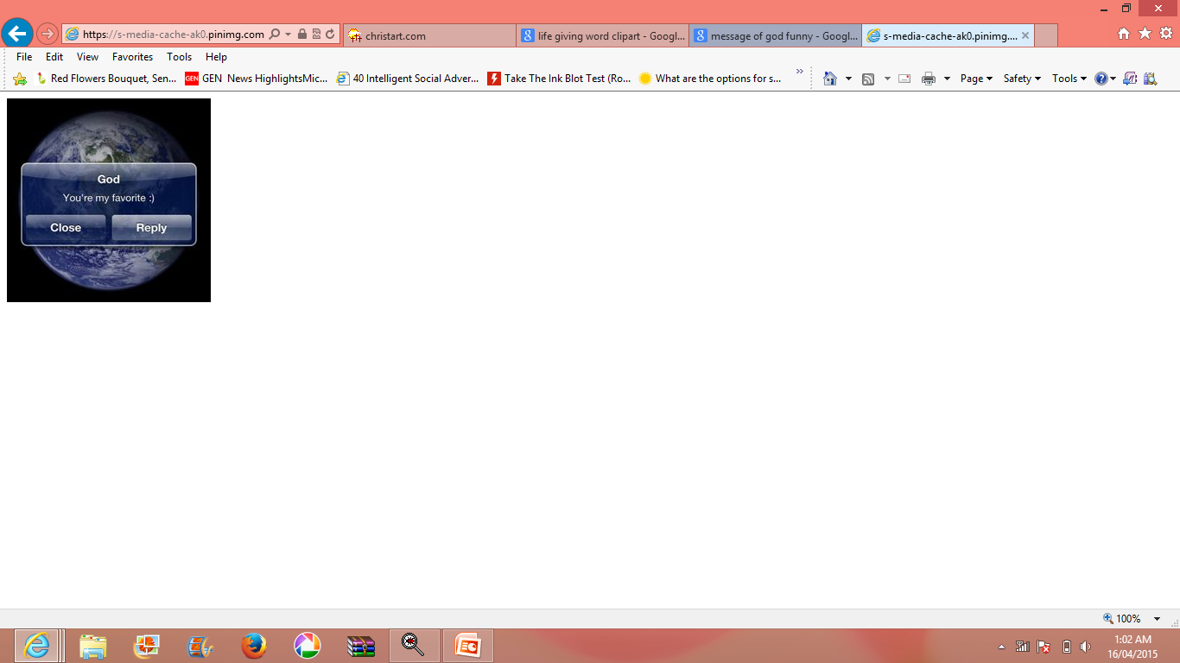

FEATURES OF THE BIBLE
A guide to life
The life giving word
The message of God
History of God Experience

Slide 6
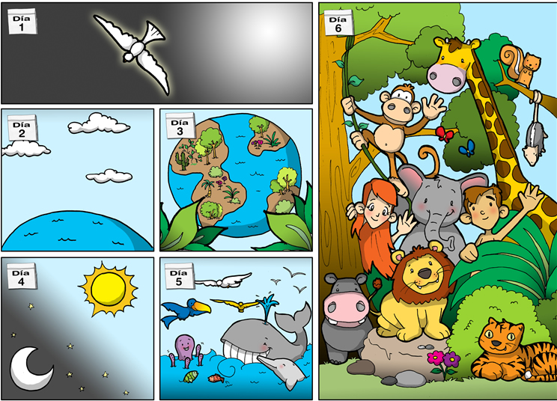
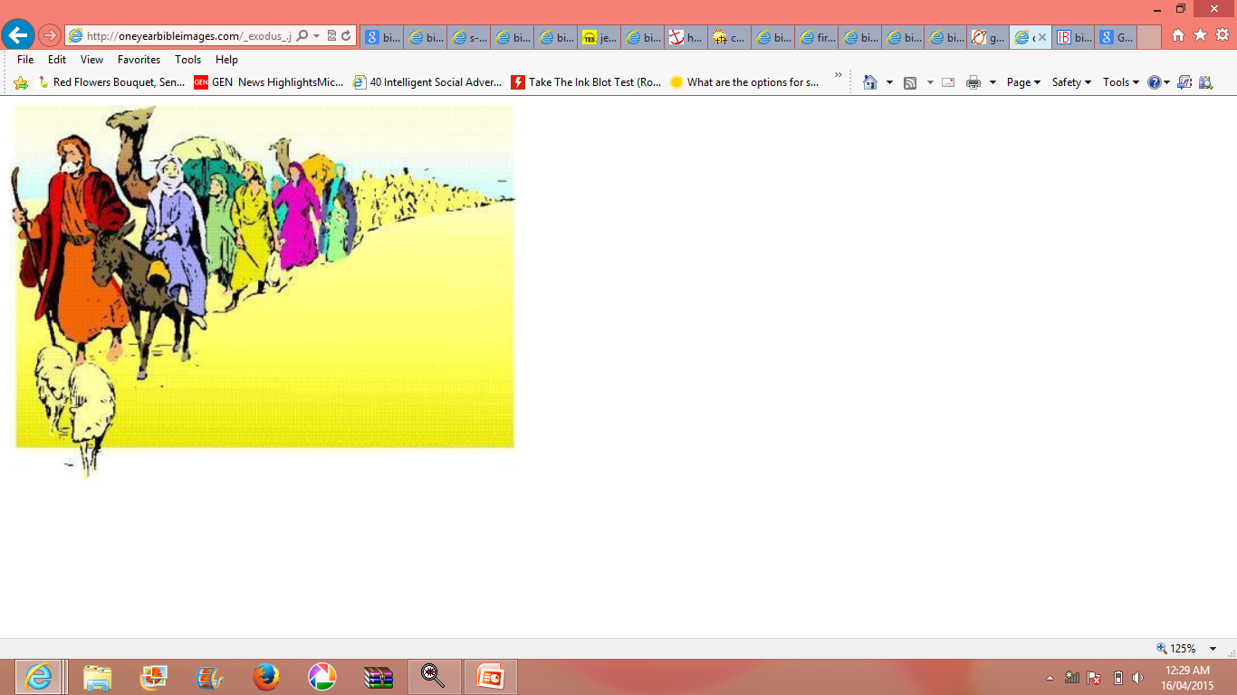
BIBLE : A GUIDE TO LIFE
Because it is the Word of God
Gives lessons on subjects like :
Beginning of universe
Origin of humans
Goal of human life
Means to attain the goal
Good human values through stories & parables
Consequences of evil actions.

Slide 7
BIBLE : THE LIFE GIVING WORD
“Man does not live by bread alone, but by every word that proceeds from the mouth of God”(Mt. 4:4)
Just as food nourishes the body, the Word of God nourishes the soul.
Word of God is life and spirit.
Word of God gives eternal life to those who listen & FOLLOW it.

Slide 8
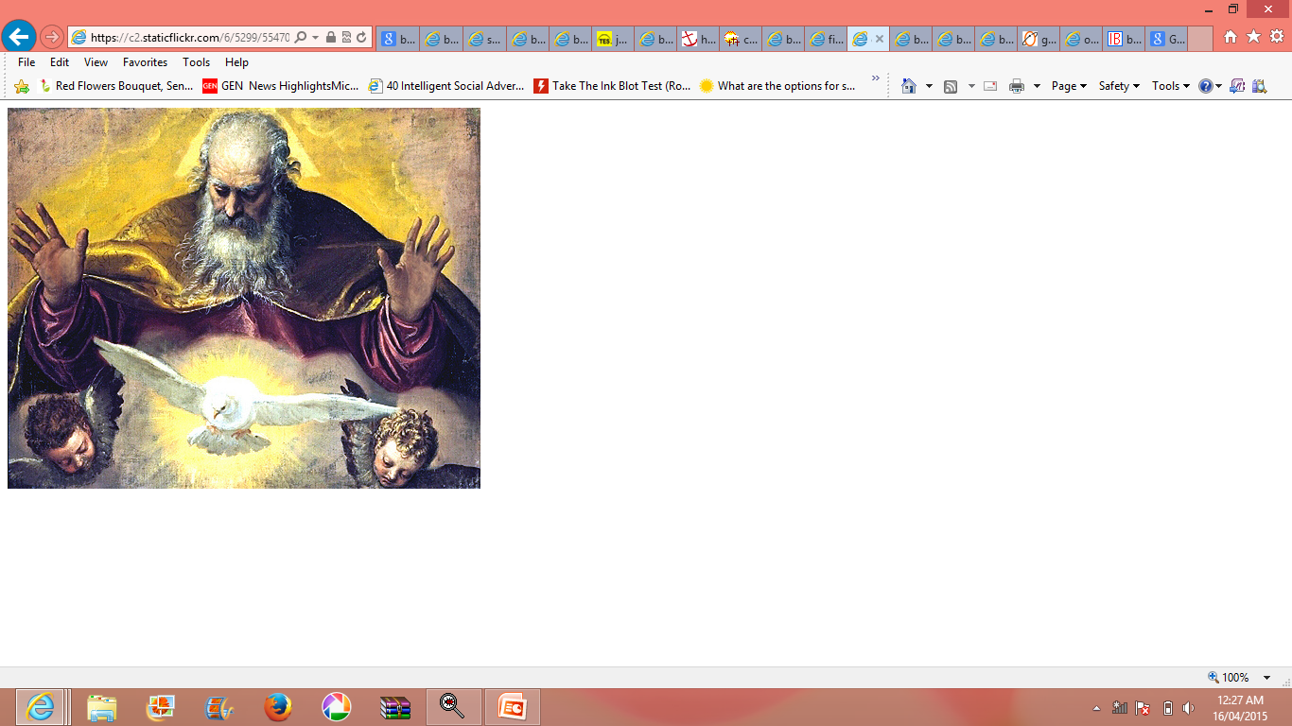
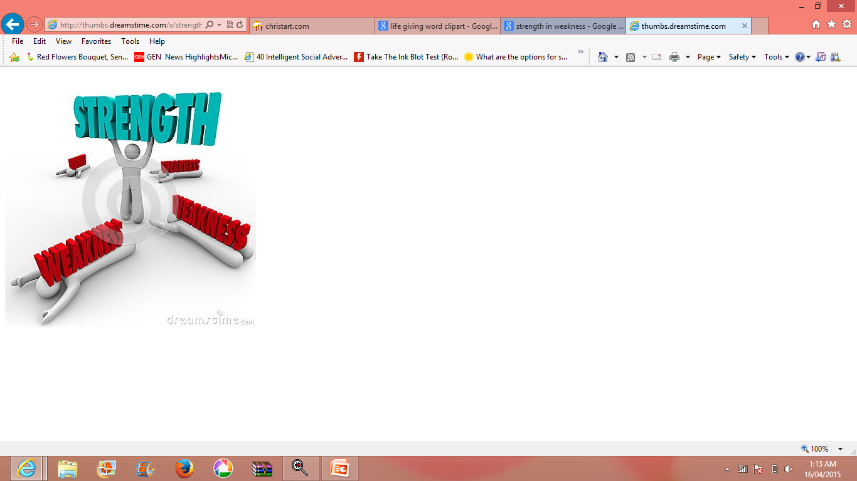
BIBLE : THE MESSAGE OF GOD
God speaks through the Bible.
Messages of love from God the Father to His children.
God reveals himself
Tells us that God lives us through the various manifestations and messages.
Word of God gives :
LIFE
COMFORT IN DISTRESS
HEALTH IN ILLNESS
STRENGHT IN WEAKNESS

Slide 9
OLD TESTAMENT – 46 BOOKS
Presents first part of God’s plan for mankind’s salvation
First 5 books called ‘ PENTATEUCH’ (Greek word - 5 books)
Malayalam - Panchagranthi
Genesis, Exodus, Leviticus, Numbers, Deuteronomy

Slide 10
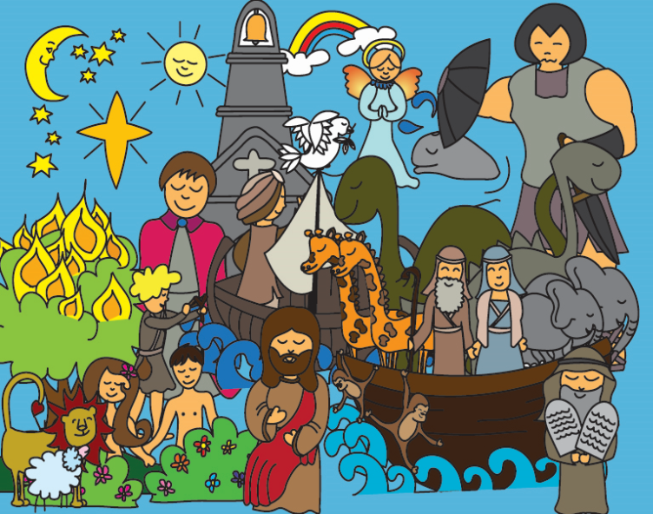
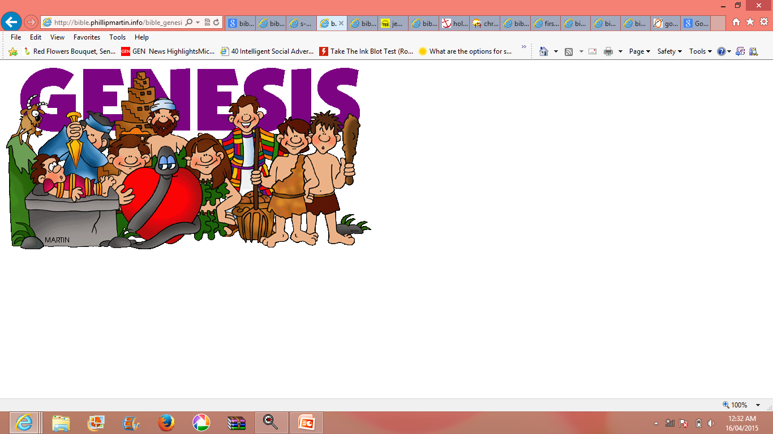
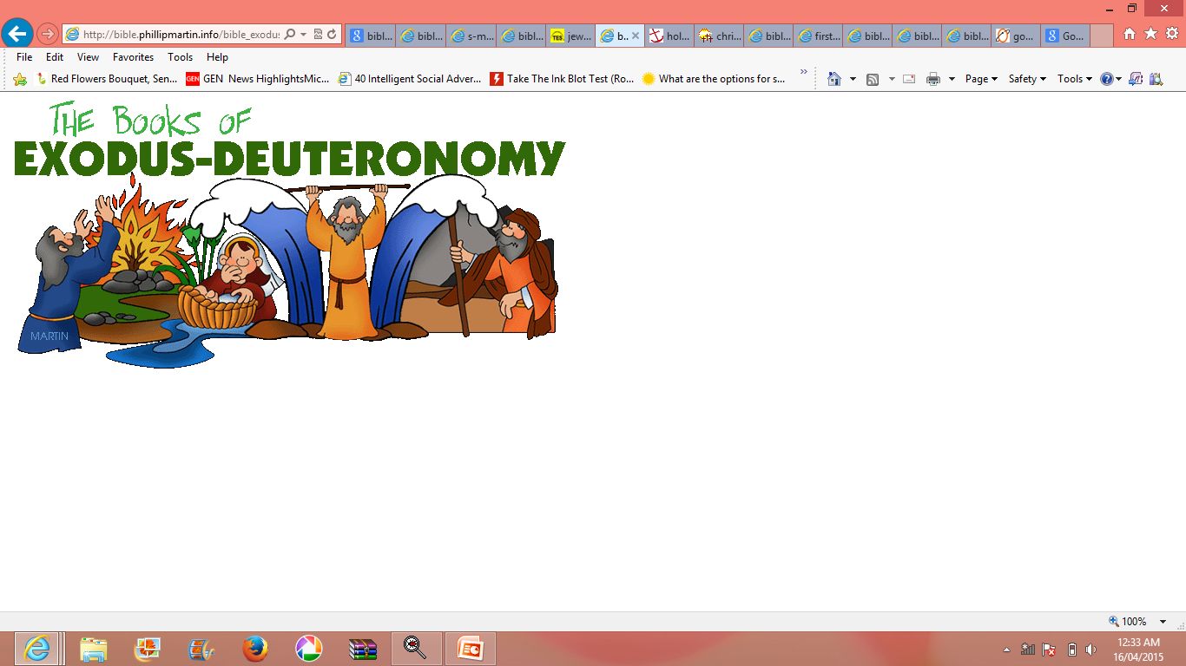
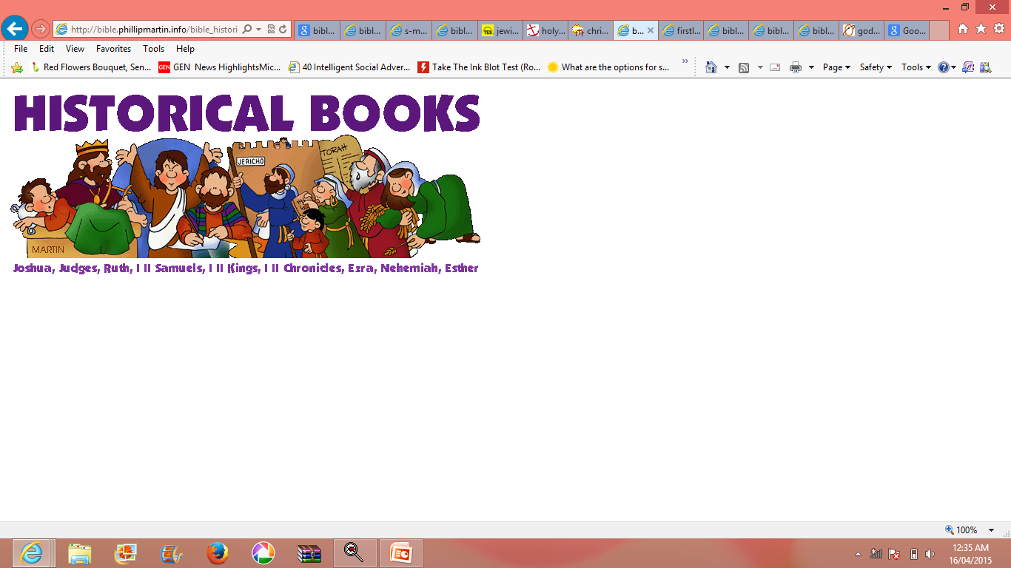

Slide 11
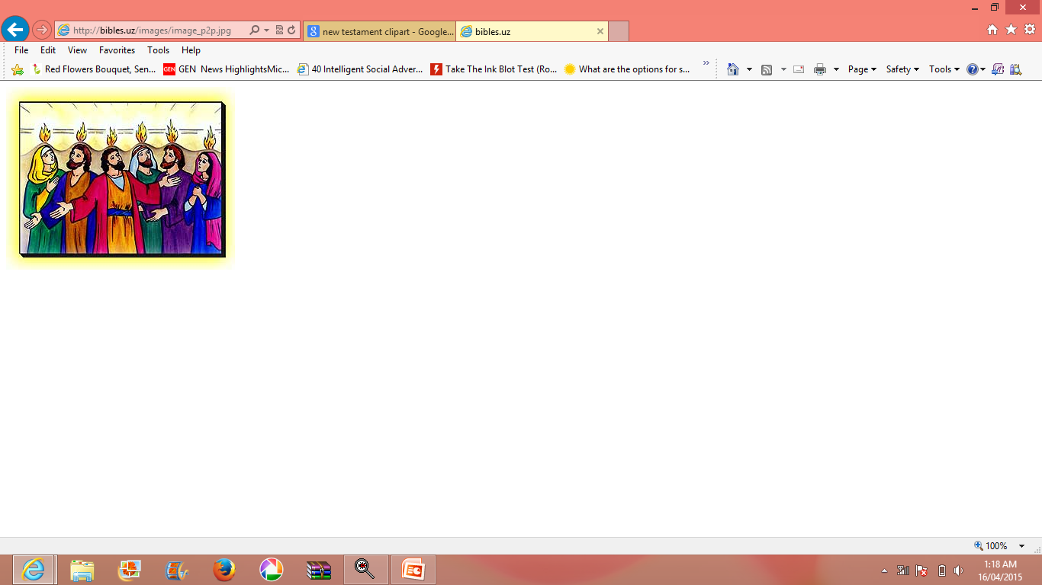
NEW TESTAMENT – 27 BOOKS
Fulfills the Old Testament
First 4 books : Gospels (life & teachings of Jesus)
Other books : Acts of Apostles, Letter of St. Paul, 7 catholic letters, Book of Revelations.

Slide 12
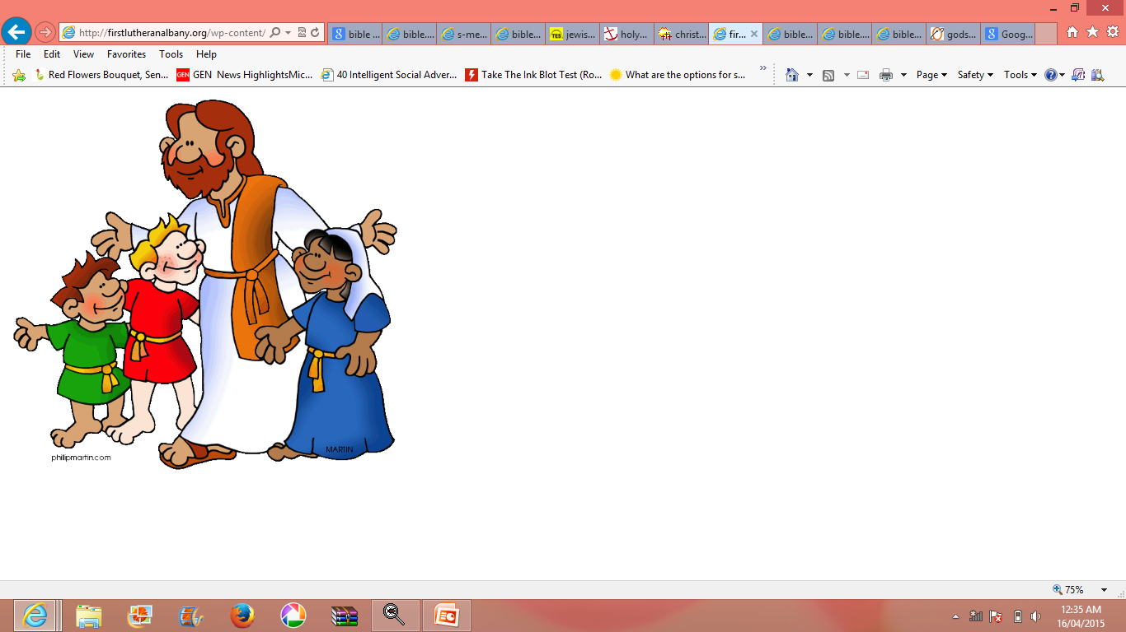
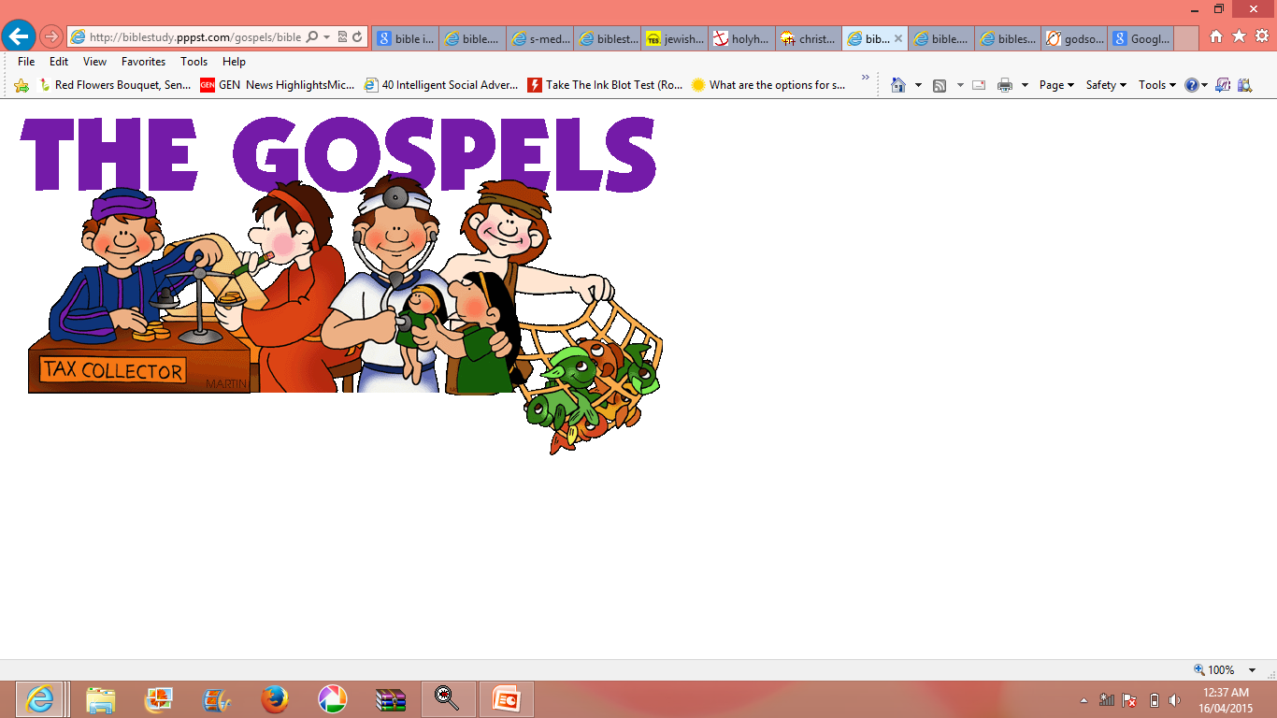
Messages of God given through Jesus and His apostles.
First 4 books : Gospels (life & teachings of Jesus)

Slide 13

Gencesis
Deuteronomy
Exodus
Pentateuch
Numbers
Leviticus

Slide 14
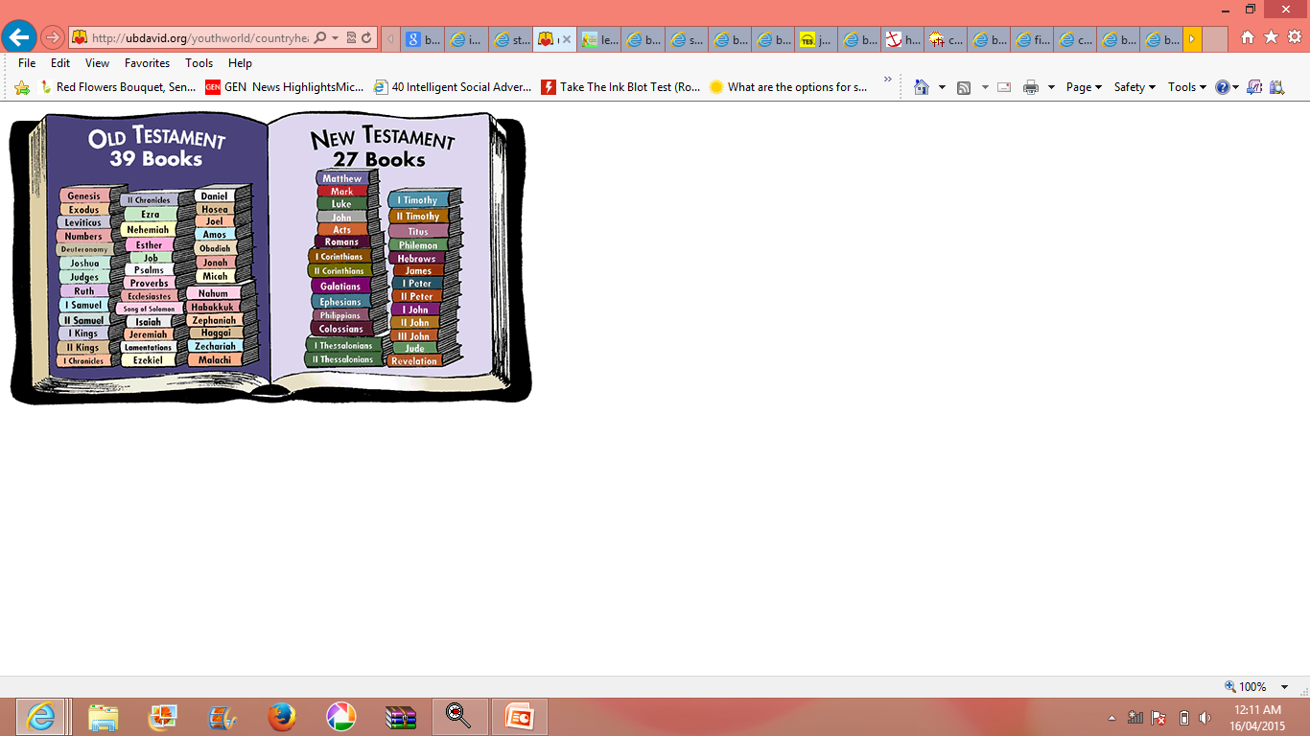
OLD TESTAMENT
46 BOOKS
NEW TESTAMENT
27 BOOKS
History of Israel is the main subject.
God selects people of Israel as His chosen ones.
Son of God(Jesus) and his teachings is the main subject.
God sends His only Son to gather the faithful.

Slide 15
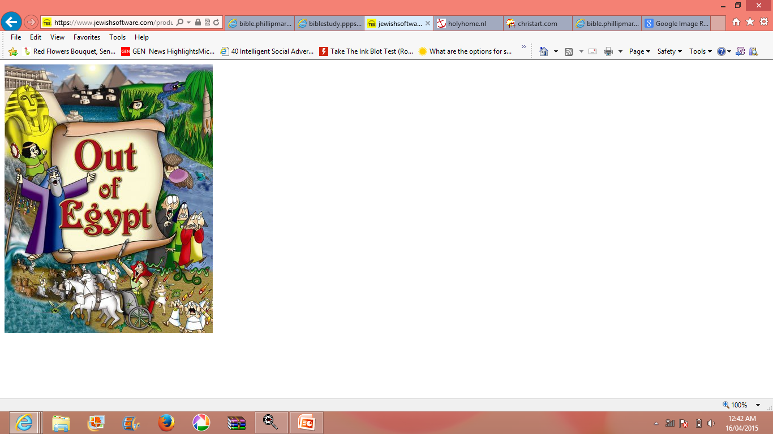
BIBLE : HISTORY OF GOD EXPERIENCE
O.T is collection of many historic events.
Record of God experience to people like deliverance from slavery Protection & care in the desert
Guidance to the promised land.

Slide 16
Let us pray
O Lord, I seek with my whole heart.
Don’t let me stray from your commandments.

Slide 17
READ AND RECOUNT
The Covenant with Noah (Gen. 9:1-17).

Slide 18

WORD OF GOD FOR GUIDANCE
Your word is lamp to my feet and a light to my path (Psalm 119:105).

Slide 19
MY DECISION
I will read the holy Bible daily with devotion.

Slide 20
LET US DO
Name the first five of the Old Testament.
....................................
....................................
....................................
....................................
....................................

Slide 21
LET US FIND OUT THE ANSWER
1. Why do we say that the holy Bible is the guide for life?
2. How do the words of the Bible become life-giving?
3. What is the content of the Pentateuch?
4. What are the books in the New Testament other than the Gospels?
5. How does the Good-experience of Old Testament people help us?

Slide 22
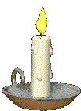


Thank you

